Slide 1
Communicable Disease Solution Design Outbreak Value Stream
Value Stage User Story Process Model

Slide 2
Communicable Disease Value Stream Network
Communicable Disease Solution Design
Outbreak Value Stream
Assess
Open
Exposure Trace
Manage
Close
Communicable Disease Episode Value Stream
Confirm
Investigate
Intervene
Close
Communicable Disease Treatment Value Stream
Register
Assess
Plan
Treat
Follow-up

Slide 3
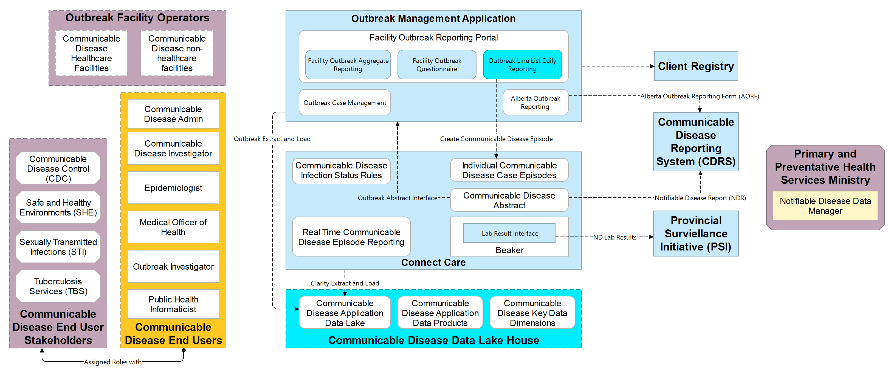
Target State Communicable Disease Solution (CDS) Architecture
Communicable Disease Solution Project
Notes:
Alec

Slide 4
Confirm Outbreak Stage
Investigator
Regulatory
Communicable Disease Solution Design
PPHST
Confirm
Open
Exposure Trace
Manage
Close
Facility Operator
Search Active/ Inactive Outbreaks
Create
Outbreak and EI # if needed
Assess Outbreak
Update Outbreak
Status
Notifi-able?
Initial Outbreak Notification
AORF Outbreak Notification
Record Outbreak Call
Outbreak Notification
Key contact + MOH Outbreak Notification

Slide 5
Open Outbreak Stage
Investigator
Regulatory
Communicable Disease Solution Design
CDC/SHE Manager
Confirm
Open
Exposure Trace
Manage
Close
Medical Officer of Health
Update Outbreak Status to Active
Update initial CD Episodes with Outbreak ID
Existing EI#?
Create
EI # if needed
Receive updated AORF
Assign initial resources to Outbreak

Slide 6
Exposure Trace Outbreak Stage
Albertan
Investigator
Regulatory
Communicable Disease Solution Design
Facility Operator
Confirm
Open
Exposure Trace
Manage
Close
Epidemiologist
Complete Questionnaire
Create/Update non-facility Line List
Match Line List to ULI
Create Outbreak (exposure) Questionnaire
Partner
Reporting
Create/ Upload Line List
Report Aggregate Facility Stats
Complete Facility Questionnaire
Create Facility Questionnaire

Slide 7
Manage Outbreak Stage
Investigator
Regulatory
Communicable Disease Solution Design
Manager
Confirm
Open
Exposure Trace
Manage
Close
Medical Officer of Health
Manage Outbreak Tasks
Outbreak Management Reporting
Create Daily Sit Reports
Review Situation Reports
Assign Outbreak Resources
Manage Outbreak Tasks
Manage Outbreak Tasks
Sign Orders

Slide 8
Close Outbreak Stage
Investigator
Ministry
Communicable Disease Solution Design
CDC/SHE Manager
Confirm
Open
Exposure Trace
Manage
Close
Medical Officer of Health
Document Closure Communications
Complete Outbreak Summary Report
Update Outbreak Status
Receive final AORF
Outbreak ready to close?

